Slide 1

The Way Forward: Consultation
The purpose of this presentation and the supporting documents are to explain why LALC is considering incorporation.

Slide 2
How does LALC fit with the other CALC’s
There are forty-one County Associations of which roughly 45% are unincorporated associations (reducing) and 55% are some form of limited company.
The county associations were set up in most cases before NALC the national association
and as a local parish or town council you cannot be a direct member of NALC
NALC’s role is distinct from the county groups as it represents all the local parish & town councils to the government and other national organisations, it produces templates, legal advice and guidance notes for the functions of local councils such as standing orders, based on current legislation

Slide 3
The Lancashire Association of Local Council
LALC is the administrative Association for Lancashire (which currently includes Blackburn & Blackpool Unitary Authorities, Lancashire County Council and twelve district councils)
Merseyside Association of Local Councils operates under the umbrella of LALC but operates as a separate association with its own chair and executive.
Greater Manchester members do not have a separate group or work with any of the District Area Committees currently

Slide 4
Lancashire Association of Local Councils: Current structure
LALC has a small part-time team lead by out Chief Officer Debra Platt and supported by Jessica Dibble
LALC does not have an office
LALC currently is managed by an Executive Committee made up of 45 nominated members from the area committees(36) & MALC (9) who delegate some tasks to the Finance & Management (F&M) committee who make recommendations to the executive committee
The President and Vice President are observers to the Finance & Management and Executive Committees
The Executive Committee meets quarterly.
Currently there are 11 District Area Committees
MALC and Greater Manchester are Metropolitan Boroughs.

Slide 5
Why is LALC considering change
LALC employs staff, enters into contracts, provides professional advice, manages personal data, delivers services to hundreds of councils and manages financial resources.
An Association has no separate legal personality. Responsibilities linked to contracts, employment, data protection and other obligations may therefore fall on individuals acting for LALC.
Our Insurers assure us that the current cover will support any issues raised as long as we are carrying out our constitutional role

Slide 6
Process so far
The Task & Finish group made up of Executive committee members explored:
Current insurance position and sought clarification
Looked at options, produced a comparison document which are in the appendix to pack and are slides 7 & 8
Legal options were clarified by Tozers

Slide 7
Courtesy of Cllr Hampson

Slide 8
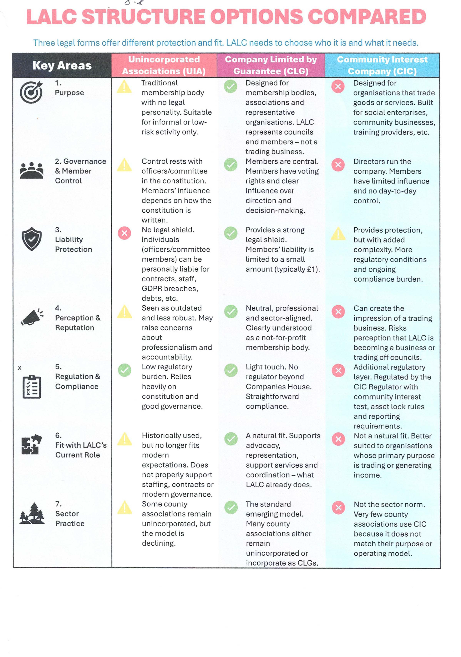
Courtesy of Cllr. Hampson

Slide 9
So what is a Company Limited by Guarantee (CLG)?
A CLG is designed for organisations such as membership bodies, professional associations, charities and representative organisations.
A CLG:
Has no member-owned shares
Limits each member's liability to £1 (the Guarantee)
Is intended to retain and reinvest any surplus rather than pay it to members
The CLG itself can employ staff, own assets, hold contracts and enter legal agreements

Slide 10
Current Position
The National Association of Local Councils position was sought and models/options explored with other County Associations
The Executive Committee agreed to progressing the Company Limited by Guarantee option
The Motion agreed by the Executive Committee for November 14th AGM

Slide 11
Motion to go to the LALC AGM on the 14th November
“That the Association Members agree in Principle to work towards a company limited by guarantee and instruct Tozers to prepare the documentation required.”
This will be followed by an Extraordinary General Meeting in January/February to accept the report and start the processes

Slide 12
Timeline
Consultation pack goes out after September 5th Executive Committee meeting
The District Area Committees are asked to present the pack to their members at a meeting in September or October and report back to the Association officers by 6th November
The pack and video are put on the website to encourage responses from parishes, towns and individual cllrs
The motion is debated and voted on at the AGM
If agreed the legal documents are prepared and presented at the EGM at the LALC conference in the new year
If agreed the company limited by guarantee comes into place for the 1st April 2027
The processes of TUPE of staff, bank accounts etc commence with the new entity working alongside the association
The 1st elections to the boards take place in June 2027 (after the Local Government elections in May 2027)

Slide 13
Help is needed from LALC members in developing the future ways of working
Agree the composition and size of the Board of Directors
Agree how the representation of member councils will be appointed or elected
Agree the role of District and emerging Unitary Area Committees
Agree what powers will be delegated powers/responsibilities will be delegated to the Board
Agree how will the Board will maintain financial governance and accountability
Agree what codes of conduct and declarations of interests the Directors will sign up to

Slide 14
Next steps
District Area Committees agree dates for their presentation meetings.
These will be posted online so if members are unable to attend their local meeting there are alternative dates available
Power point & pack on website
Consultation responses to Office by 6th November 2026
Report on consultation prepared for AGM on 14th November
EGM and LALC conference early 2027

